Slide 1
Fundamentals of HTML and CSS
By Yogeshwar Trehan

Slide 2
What is W3C?
W3C's primary activity is to develop protocols and guidelines that ensure long-term growth for the Web.
A few history bits
Tim Berners-Lee wrote a proposal in 1989 for a system called the World Wide Web. He then created the first Web browser, server, and Web page. He wrote the first specifications for URLs, HTTP, and HTML
In October 1994, Tim Berners-Lee founded the World Wide Web Consortium (W3C) at the Massachusetts Institute of Technology, Laboratory for Computer Science [MIT/LCS] in collaboration with CERN, where the Web originated with support from DARPA and the European Commission.

Slide 3
Web accessibility
Web accessibility focuses on ensuring equivalent access for people with disabilities
Who is impacted?
Web accessibility addresses all disabilities, including hearing, learning and cognitive, neurological, physical, speech, and visual disabilities. Some examples of Web accessibility features include:
Captions on audio and multimedia content for people who are hard of hearing;
Clear and consistent layout for people with learning and cognitive disabilities;
Keyboard support for people with physical disabilities and who do not use a mouse;
Text alternatives for people with visual disabilities and who are using screen readers;

Slide 4
Page title - they are:
shown in the window title bar in some browsers
shown in browsers' tabs when there are multiple web pages open
shown in search engine results
used for browser bookmarks/favorites
read by screen readers
Good page titles are particularly important for orientation — to help people know where they are and move between pages open in their browser. The first thing screen readers say when the user goes to a different web page is the page title.
What to do:
Look at the page's title (or with a screen reader, listen to it).
Look at titles of other pages within the website.
What to check for:
Check that there is a title that adequately and briefly describes the content of the page.
Check that the title is different from other pages on the website, and adequately distinguishes the page from other web pages.

Slide 5
For example:
Poor titles:
Welcome to home page of Acme Web Solutions, Inc.
Acme Web Solutions, Inc. | About Us
Acme Web Solutions, Inc. | Contact Us
Acme Web Solutions, Inc. | History
Better page titles:
Acme Web Solutions home page
About Acme Web Solutions
Contact Acme Web Solutions
History of Acme Web Solutions
https://www.w3.org/TR/UNDERSTANDING-WCAG20/navigation-mechanisms-title.html

Slide 6
Image text alternatives ("alt text")
Text alternatives ("alt text") convey the purpose of an image, including pictures, illustrations, charts, etc. Text alternatives are used by people who do not see the image. (For example, people who are blind and use screen readers can hear the alt text read out; and people who have turned off images to speed download or save bandwidth can see the alt text.)
What to check for:
Every image has alt with appropriate alternative text.

Slide 7
Tips
The text needs to convey the same meaning as the image. That is, if someone cannot see the image, they get the important information from the image in the alternative text.
Alternative text depends on context. For example, for an image of a dog on a kennel club website, the alt text might include the breed of the dog; however, the same image on a dog park website may be there just to make the page more attractive, and the image might not need any alt text (and should have null alt). One way to help think about appropriate alt text is: if you were helping someone read and interact with the web page and they cannot see it, what would you say about the image?
Images that are functional — for example, images that initiate actions (like submit buttons) and linked images (like in navigation) — need alt text that is the functional equivalent.
If there is text in the image — for example, in a logo — that text needs to be included in the alt text.
If the image has complex information — such as charts or graphs — the image should have a short alt text to identify the image, and then the detailed description of the information should be provided elsewhere (for example, in a data table).

Slide 8
What is not needed in the alt text:
If the image is not important for understanding the content — for example, it is just decoration or "eye candy" — it should have null alt (alt=""). One way to help determine if an image should have null alt is to ask yourself: If the image was removed, would the user still get all the information from the page?
The alternative text does not need to include the words "button", "link", or "image of". (Screen readers automatically provide that information.)
If the image is sufficiently described in the text — for example, a simple diagram illustrating what's written in the web page text — it can have brief alt text such as "Diagram of work flow as describe above."

Slide 9
To check alt text with WebDev toolbar
Open the web page you are checking.
In the toolbar, select "Images", then "Outline Images", then "Outline Images Without Alt Attributes". Red boxes appear around any images missing alt.

Slide 10

Headings
Heading levels should have a meaningful hierarchy, e.g.:
Heading Level 1 <h1>
Heading Level 2 <h2>
Heading Level 3 <h3>
Heading Level 3 <h3>
Heading Level 2 <h2>
Heading Level 3 <h3>
Heading Level 4 <h4>
Heading Level 4 <h4>
Heading Level 2 <h2>

Slide 11
What to check for:
The page has a heading. In almost all pages there should be at least one heading.
All text that looks like a heading is marked up as a heading.
All text that is marked up as a heading is really a conceptual section heading.
The heading hierarchy is meaningful. Ideally the page starts with an "h1" — which is usually similar to the page title — and does not skip levels; however, these are not absolute requirements.
To check headings with WebDev toolbar
Open the web page you are checking.
In the toolbar, select "Information", then "View Document Outline".
A new page opens with the outline.

Slide 12
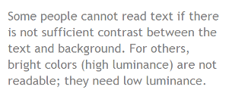
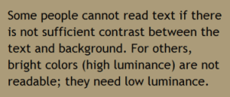
Contrast ratio ("color contrast")
Some people cannot read text if there is not sufficient contrast between the text and background, for example, light gray text on a light background.
While some people need high contrast, for others — including some people with reading disabilities such as dyslexia — bright colors (high luminance) are not readable. They need low luminance

Slide 13
Tips
Web browsers should allow people to change the color of text and background, and web pages need to work when people change colors.
What to check for:
Web pages should also have a minimum contrast by default: a contrast ratio of at least 4.5:1 for normal-size text.
There are basically three ways to check contrast, each with strengths and weaknesses.
Table with contrast ratio - The tool displays a table with all the possible contrast ratios in the web page. With some tools, you can click in the table and it will show where that color combination is in the web page.
Pro: Comprehensive.
Con: Can be inaccurate, specifically, it can show some color combinations that are not really in the displayed page.
Eye-dropper to select colors - The tool lets you select a text color and a background color, then it shows you the contrast ratio.
Pro: Accurate.
Con: Can only test one item at a time. Need to be able to see and use a mouse.
Turn off color. The tool shows the page in grayscale.
Pro: Gives you direct experience.
Con: Imprecise, does not provide contrast ratio value

Slide 14
What is internationalization?
to make it possible to use Web technologies with different languages, scripts, and cultures.
basic internationalization features, such as character encoding and language declarations
'Internationalization' is sometimes abbreviated to 'i18n' in English
Internationalization Checker by W3C
Internationalization Techniques
Unicode
Text in a computer or on the Web is composed of characters. Characters represent letters of the alphabet, punctuation, or other symbols.
Unicode is a universal character set, ie. a standard that defines, in one place, all the characters needed for writing languages in use on computers. It is a superset of all other character sets that have been encoded.
As a content author or developer, you should nowadays always choose the UTF-8 character encoding for your content or data

Slide 15
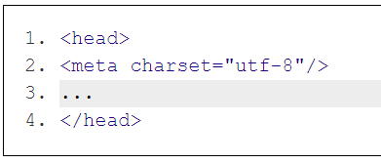
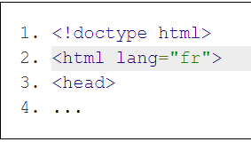
First steps in Web internationalization
Character encoding declaration
A character encoding declaration is vital to ensure that the text in your page is recognized by browsers around the world,
Primary language declaration
it's important for a browser to know what language your page is written in, including font selection, text-to-speech conversion, spell-checking, hyphenation and automated line breaking, text transforms, automated translation, and more. You should always indicate the primary language of your page in the <html> tag.
Cultural bias
If your content will be seen by people from diverse cultures, check that your cultural references will be recognized and that there is no inappropriate cultural bias

Slide 16
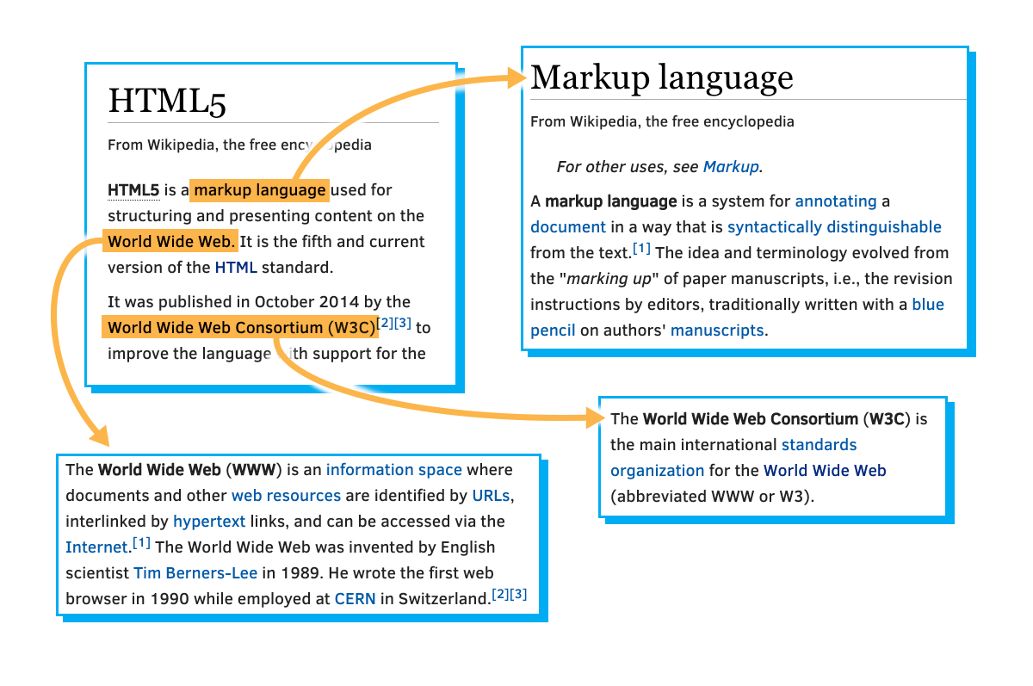
Hypertext is built on the idea of linking information together,
The idea was to "Mark Up" your document with links and define how to break it down into different segments (chapters, sections, paragraphs, tables, figures, etc.)

Slide 17
The first thing in HTML file is a tag to tell you what type of HTML file it is:
<!DOCTYPE html>
the first thing the browser sees is the declaration
at the top of an HTML 4.01 page, you might have something like this:
<!DOCTYPE HTML PUBLIC "-//W3C//DTD HTML 4.01//EN" "http://www.w3.org/TR/html4/strict.dtd">
HTML character references
If you want to use a named character reference in your source code, use an ampersand symbol '&', followed by the name and a semi-colon. Names are case sensitive. For example, the following represents a no-break space:
&nbsp;
If you are using a decimal number, use an ampersand symbol '&' , followed by the symbol '#', then a decimal number and a semi-colon.
&#160;
If you are using a hexadecimal number, use an ampersand symbol '&' , followed by the symbols '#x', then a hexadecimal number and a semi-colon.
&#x00A0;

Slide 18
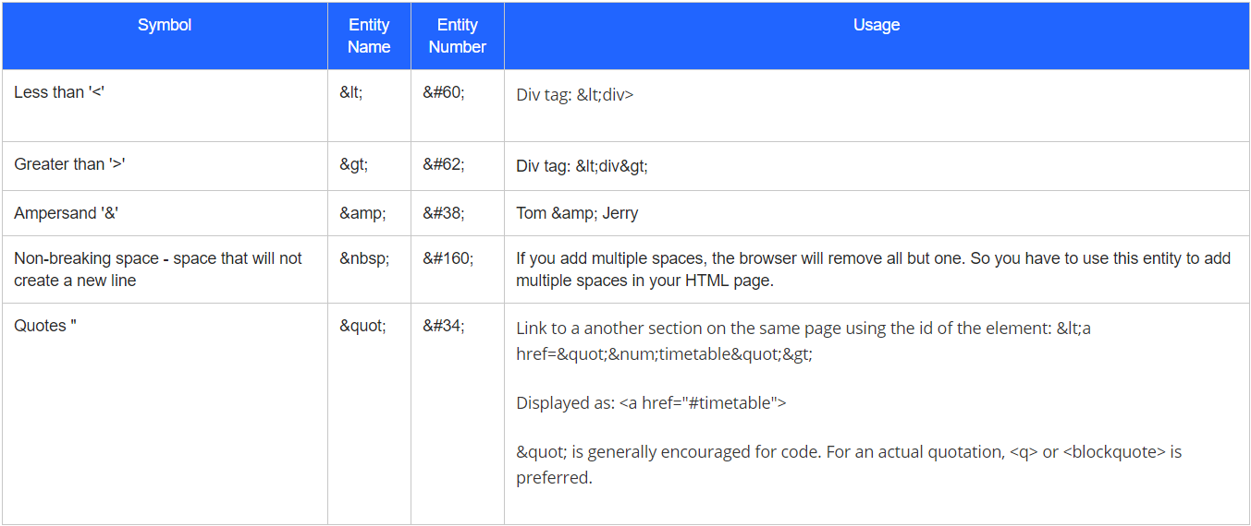

Slide 19
Tags
<!doctype> - This tag is special. In fact, many folks don't even consider it a tag, as it is officially the DTD - Document Type Declaration. Unlike most tags, it has no closing tag, not even a "/" at the end. It is there to declare exactly what type of HTML the computer will find in this file. It is used as that: <!DOCTYPE html>
<html> - The html open and close tags wrap around nearly everything in your html file (except the doctype tag). This essentially contains all of the HTML code in the file, which is generally everything (one big html element). In the next module, we will learn about attributes, and you will learn that you should always add a lang attribute to the html opening tag, to identify the default language of your page.
<head> - The head element is where you put information that does not really appear in the body of the work. For example, the <title> of the page, which typically appears on the window containing the page, is defined in the head section.
<body> - The body section contains all of the content of your page, essentially what the user sees. This could be text, pictures, links, videos, tables and so on. In addition to the content, the body usually contains lots of other elements, each indicated by their own tags.
<h1> - There are a whole collection of 'h' tags, <h1>, <h2>, <h3> . . . all the way up to <h6>. Why there are 6 rather than 5 or 7 may be a bit of a mystery, but there it is. They're generally used the same way you would use chapter or section headings in a book (don't confuse the h here with the <head> section, that is completely different). An <h1> tag might be used as the title of the document (as it appears on the page, not the same as the aforementioned <title> element), or to indicate the outermost level in a group of nested sections.

Slide 20
<q> - The q tag is for quotes. This has no relationship to the somewhat confusing single and double quote characters, rather it's used when you want to quote a person or written work in your Web page. It is customarily displayed using quotation marks, again unrelated to strings. Thus <q>Brevity is beautiful</q> would be rendered as Brevity is beautiful.
<blockquote> - If you want to quote a larger passage, you may want to use blockquote, which will typically set the quoted text apart from the surrounding text and indent it, to make clear that it is quoted text:
<ul>, <ol> - These two tags are used to indicate a list of things. The only difference is that <ol> is an "ordered" list, meaning the elements are in a particular order, and it might be a good idea to number them. The "u" in <ul> stands for "unordered" and is used for a list of things where the order doesn't really matter, so it is usually rendered as a bulleted list, or something else without numbers.
<li> - The li element is a "List Item", i.e. one item in the list. As you might expect, this element only really makes sense nested inside a list (<ul> or <ol>). In the final rendering, each li element would typically be preceded by a number or bullet, or something similar (but not necessarily). Thus a list in HTML would be look something like this:
<hr> - This one might be debatable. HR originally stood for "Horizontal Rule", i.e. a horizontal line across the width of the text. It's still there in HTML5, but now is officially supposed to represent a "thematic break" in the content. It would typically look like this:

Slide 21
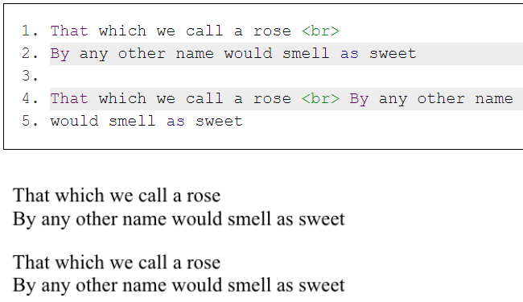
<br> - This one signifies a line break. It is used for any number of purposes. For example it can be an easy way to make sure that lines of poetry break where they're supposed to (less verbose than requiring each line to be a separate element). Essentially it helps break the "white space" rule: where spaces and carriage returns are generally treated the same, the <br> tag is treated as a required carriage return. Because it's an empty tag (doesn't contain any text or anything, just indicates a particular point in the text), it doesn't really need a close tag, so it can be written as <br>, though <br /> is also acceptable. Oddly, in the browsers I tried, if you do add a close tag, as in <br></br>, the close tag is interpreted as a regular br tag, thus you get two line breaks in a row. One other thing to remember is that the <br> tag implies a break even if there is no break in the text containing it, i.e. these two sentences would be formatted exactly the same:

Slide 22
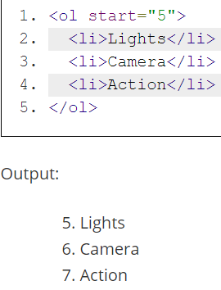
<pre> - This is another tag that helps you break the white space rule. PRE stands for "PREformatted text", meaning "I've set this up just the way I want it, don't mess with it." It generally implies a monospace font, and none of the spaces, tabs or carriage-returns are ignored. It is very handy for illustrating bits of program code, or other "typewritten" material:
<pre>
<h1>Page Heading</h1>
<p>And here is the first paragraph</p>
</pre>
Introduction to attributes
If i want an ordered list to start with the number 5 instead of 1 (as it does by default), let's code like this:
Here, using the start attribute, we made our list start with 5 instead of 1.

Slide 23
Syntax:
Attributes are used in tags to further define the tag:
It is used inside the opening tag it is applied to and should be added after a space from the tag name: <ol start="5”>
start="5"
Attribute name, equal sign, opening quote, attribute value, closing quote
Attributes are a name-value pair: start="5"
name: start
value: any positive integer
The only exception to the name-value pair is if the attribute is a 'boolean attribute'. These attributes have only two types of values - true or false. But instead of writing "true" or "false" for its value, you add the attribute name to indicate true and omit it to indicate false. An example is the 'reversed' attribute in an ordered list <ol>. Adding this attribute is an indication that the list order should be reversed (in descending order).
<ol reversed></ol>
The order in which the attributes are specified in the opening tag does not matter.
A tag can have multiple attributes:
<ol id="cinema" class="attribute-list" start="5"></ol>

Slide 24
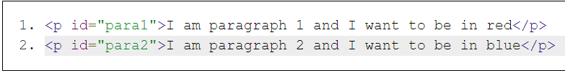
the 'id' attribute
unique name we give to each element is called an 'ID'.
Naming rules for id attribute:
Must be of at least one character
Should not contain any spaces
Values are case-sensitive
id is primarily used for:
Styling your element. You can specify the style you want for the element in your style sheet by referencing the 'id'.
Specifying a link target.
<a href="#introduction">1.1 Introduction</a>
<!-- This is a hyperlink element which we will learn about later in this week -->
<p id="introduction">This paragraph is the Introduction to the Web page</p>
In JavaScript, 'id' can be used to manipulate an html element. Using the 'id' of the element, you can write JavaScript code to make it perform an action, i.e. change the text within paragraph tags.

Slide 25
the 'class' attribute
You like poems and you want to include at least 20 of them in your new book. You add IDs for them: 'poem1', 'poem2', 'poem3'.
You want your poems to look different from your other text. Grey text color, italic and bold
So all poems have the same requirements.
If you use id attribute, you can instruct the stylesheet to style each poem in a particular way.
Can you imagine how repetitive your style sheet will look if you have to instruct it to do the same thing 20 times for different poem IDs? HTML makes it easier. We use the class attribute. Let's name this class of poems 'poetry'.
Naming rules for class attribute:
Must begin with a letter (a-z or A-Z)
First letter can be followed by a letter, digit, hyphen or underscore
Values are case-sensitive

Slide 26
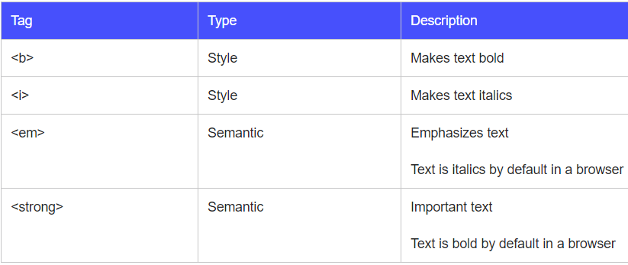
Semantic vs Style tags

Slide 27
<b> vs <strong>
Bold is a style that makes letters thicker so it stands out among other text but it has no semantic meaning, for example for voice browsers, screen readers, and other types of ways to access the Web. A device like Kindle Paperwhite that renders text differently, might not pick up the bold.
Strong is an indication of how something should be. It looks like bold in a browser, but it could mean ‘speak with urgency or seriousness’ when reading text aloud. It is semantic in the sense, that we instruct it to be stronger than the text it surrounds which is different from giving instructions on how the text should look in the case of <b>. It represents importance, seriousness, or urgency for its contents.
<p>As a junior developer, you <strong>must</strong> submit your work for code review!</p>

Slide 28
<i> vs <em>
Italics slants text. We usually italicize names of magazine, books, TV shows etc. Just like the bold tag, since it is meant purely for presentation purposes, it means nothing to someone who cannot read the text.
Emphasis is used to stress emphasis of its contents. The word in a sentence you emphasize can change the whole meaning. Try reading the sentences below out loud, stressing on the emphasized words: 'you' and 'store'.
You have to go to the store.
Not me. That’s your job!
You have to go to the store.
To the store. Not the arcade.

Slide 29
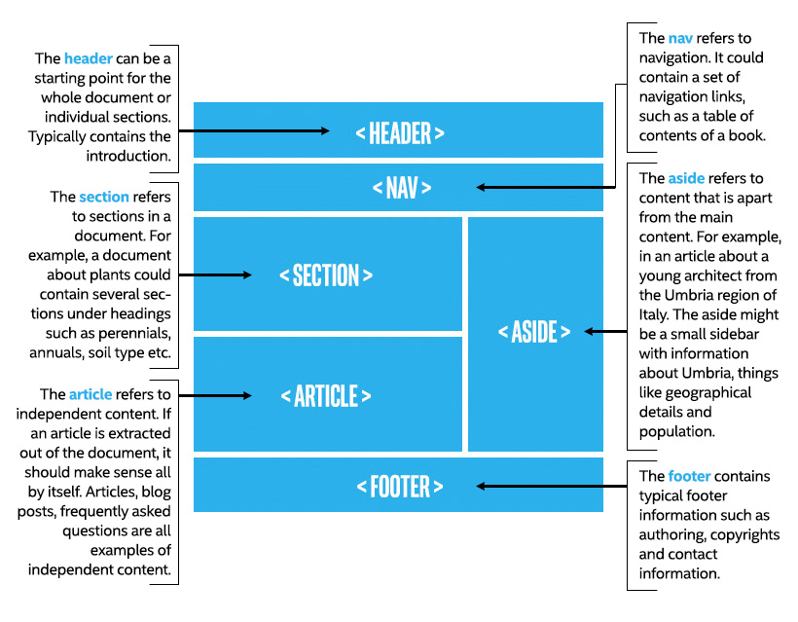
see how each section refers to a part of the document

Slide 30
Tags such as <article>, <section>, <header>, <nav> and <footer> were specifically introduced in HTML5 to define the Web page structure. These new semantic elements give meaning to different parts of a webpage. When you do a Google search, the search engine automatically processes millions of HTML pages to scan and offer you the most appropriate content.
The use of these semantic elements improves the automated processing of documents. When it scans a <nav> tag, it automatically knows it includes content related to page navigation or a header indicates introductory content. It provides the structure and consistent behavior across many webpages providing simpler and more direct information to browsers making life easier for them. It also improves the accessibility of webpages. Assistive technologies depend on the structure of the document to present information to the users. If a screen reader can correctly determine the structure of a document, it reads the document more seamlessly and avoids irrelevant information or repeating conte

Slide 31
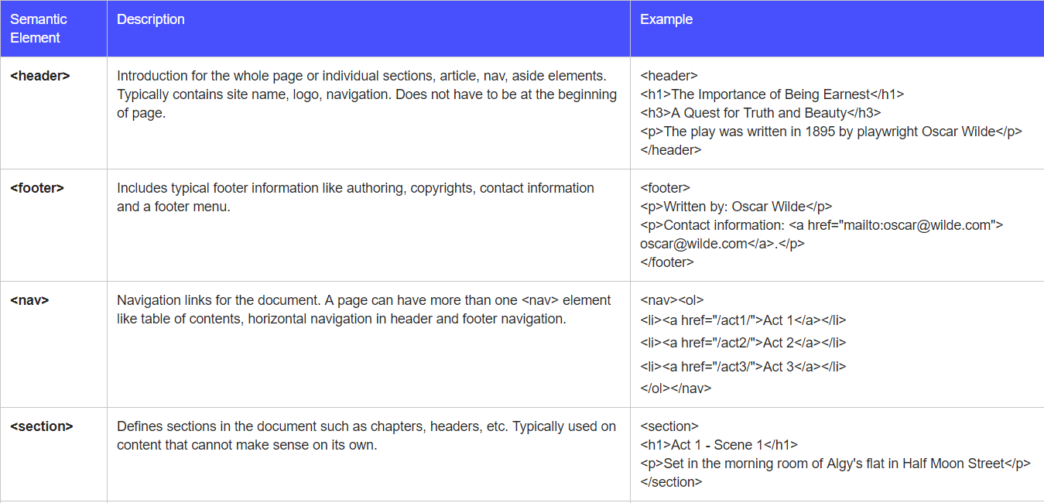
New HTML5 semantic elements

Slide 32
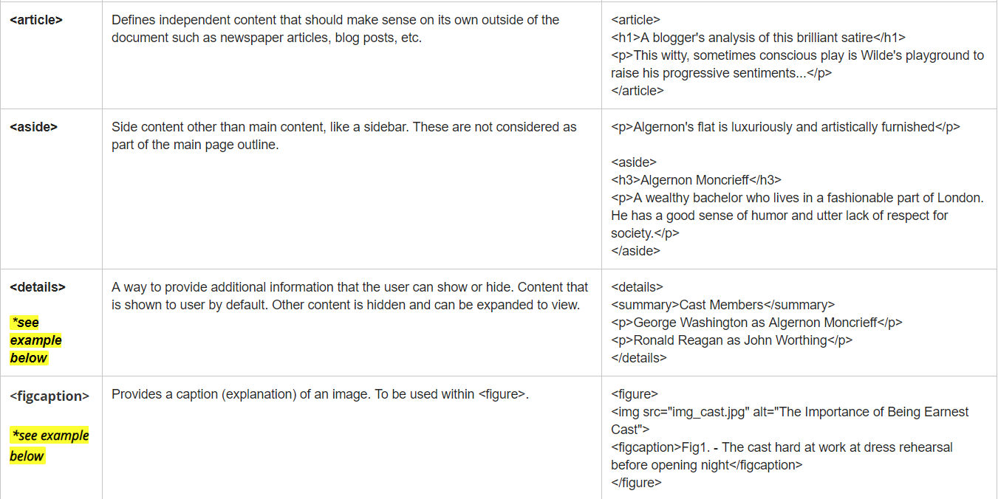

Slide 33
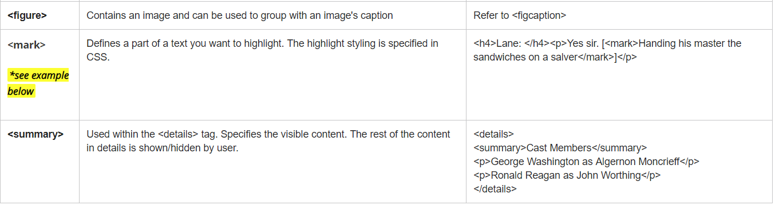

Slide 34
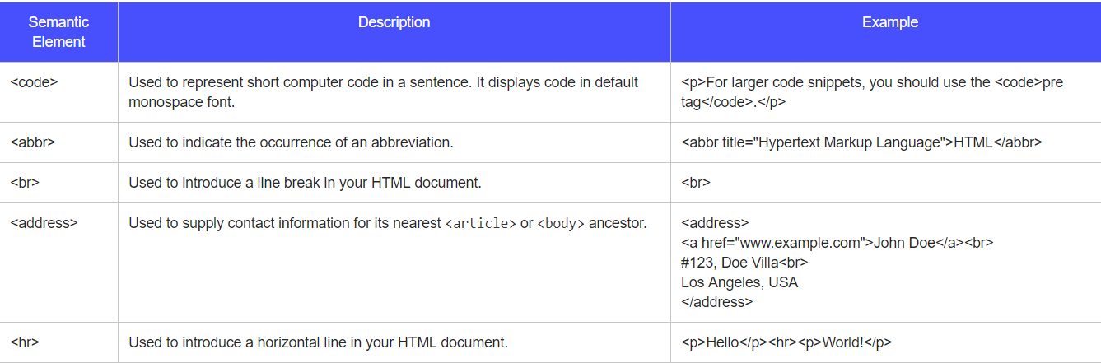
The HTML Citation element (<cite>) is used to describe a reference to a cited creative work, and must include either the title or author or the URL of that work. The reference may be in an abbreviated form according to context-appropriate conventions related to citation metadata.
more on <cite>

Slide 35
Using right Image format
When using images in your HTML5, there are a few image format related information to be aware of.
Image data: most images, especially JPEG, contain a lot more data than is needed for a browser and are too often overly large and slow.
JPEG (Joint Photographic Experts Group) images compress well and are the standard for photos. But they don’t support any sort of animation or transparency.
PNG (Portable Network Graphics) images support transparency and alpha channels. This makes them useful for non-rectangular images that may need to overlay different background colors or other elements on the page.
SVG (Scalable Vector Graphics) are defined mathematically and support animation. Also, since they are defined mathematically they scale to Logo Scalable Vector Graphics (SVG) any size without worrying about pixels, resolution or image data. This makes SVG images an excellent format to use, if possible. SVG is great for charts, graphs, maps, geometric shapes, and line based illustrations. SVG is also a markup language in its own right and is very similar to HTML. Typically, it is created with vector graphic software (like Inkscape, Adobe Illustrator, and others), but some people write the markup by hand.
Search engines do not 'see' images. They rely on the alt attribute to find out what the image is about. If you use your target keyword in alt, it will optimize the search.

Slide 36
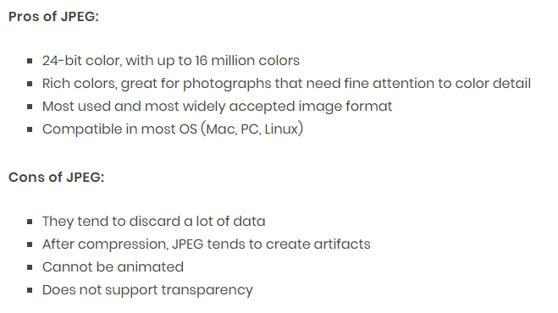

Slide 37
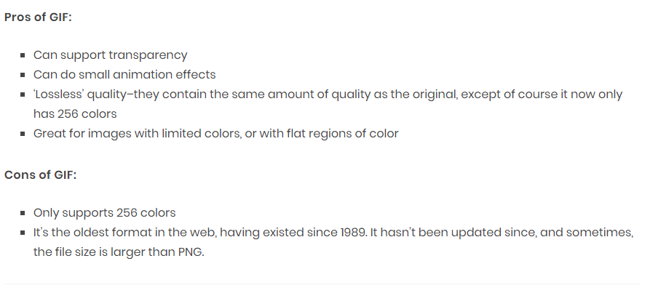

Slide 38
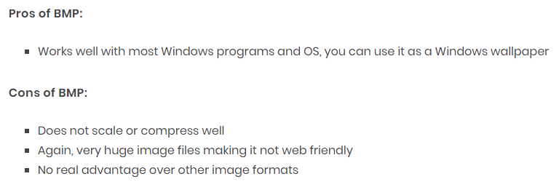

Slide 39
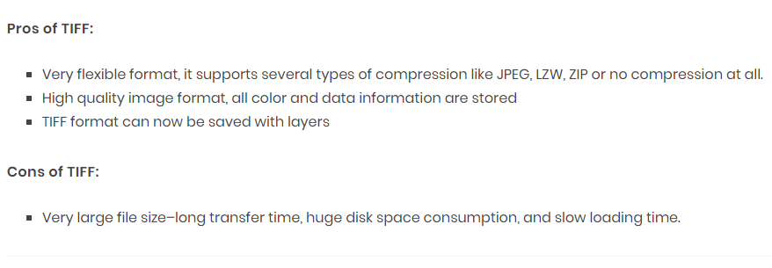

Slide 40
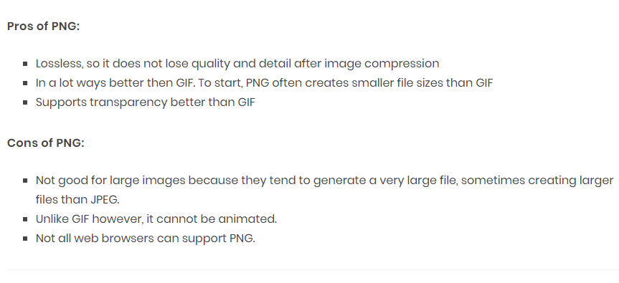

Slide 41
Hyperlink is any text or image you can click and it will take you to another page. This page can be:
another Web page: e.g. the hyperlinks wiki page at https://en.wikipedia.org/wiki/Hyperlink
a bookmark (a specific part of a Web page): e.g. the History section of the Hyperlinks wiki page at https://en.wikipedia.org/wiki/Hyperlink#History
The hyperlink tag in html is simply <a>, and it is called the anchor element. Here is how it is used:
<a href="https://en.wikipedia.org/wiki/Hyperlink">Click here</a> to go to the Wikipedia Hyperlink page.
States of a hyperlink:
If the link has not been clicked, it will be blue and underlined.
Now, click on the link and you will see that a visited link looks purple and underlined.
Apart from unvisited and visited links, there is also a status called active link. A link becomes active while the user is clicking on it.
The 'href' attribute
- points to the URL that the link should jump to
target specifies the destination where the linked URL in href should be opened
Target=“_self” will open link in same window
Target=“_blank” will open link in new window

Slide 42
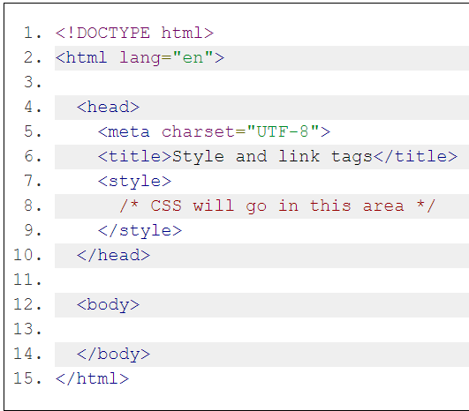
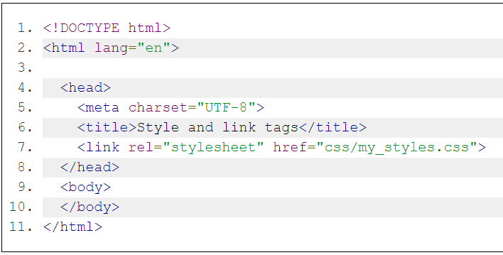
<style> tag
To place CSS directly into an HTML document, we use the <style> tag. This tag can appear anywhere in an HTML document, however, the most common practice is to place it in the <head> section
<link> tag
the better practice is to put the CSS into a separate file. One of the key advantages of using a separate file is that the CSS styles can easily be re-used between your different .html pages.

Slide 43
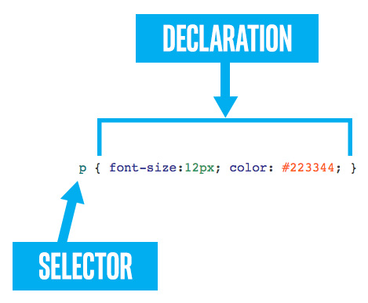
At its simplest, CSS is just a list of rules. Each rule consists of a selector and a declaration. Here is an example:
Comments begin with /* and must end with */

Slide 44
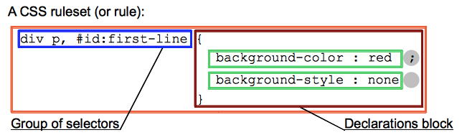
Selectors can be divided into the following categories:
Simple selectors: Match one or more elements based on element type, class, or id.
Attribute selectors: Match one or more elements based on their attributes/attribute values.
Pseudo-classes: Match one or more elements that exist in a certain state, such as an element that is being hovered over by the mouse pointer, or a checkbox that is currently disabled or checked, or an element that is the first child of its parent in the DOM tree.
Pseudo-elements: Match one or more parts of content that are in a certain position in relation to an element, for example the first word of each paragraph, or generated content appearing just before an element.
Combinators: These are not exactly selectors themselves, but ways of combining two or more selectors in useful ways for very specific selections. So for example, you could select only paragraphs that are direct descendants of divs, or paragraphs that come directly after headings.
Multiple selectors: Again, these are not separate selectors; the idea is that you can put multiple selectors on the same CSS rule, separated by commas, to apply a single set of declarations to all the elements selected by those selectors.

Slide 45
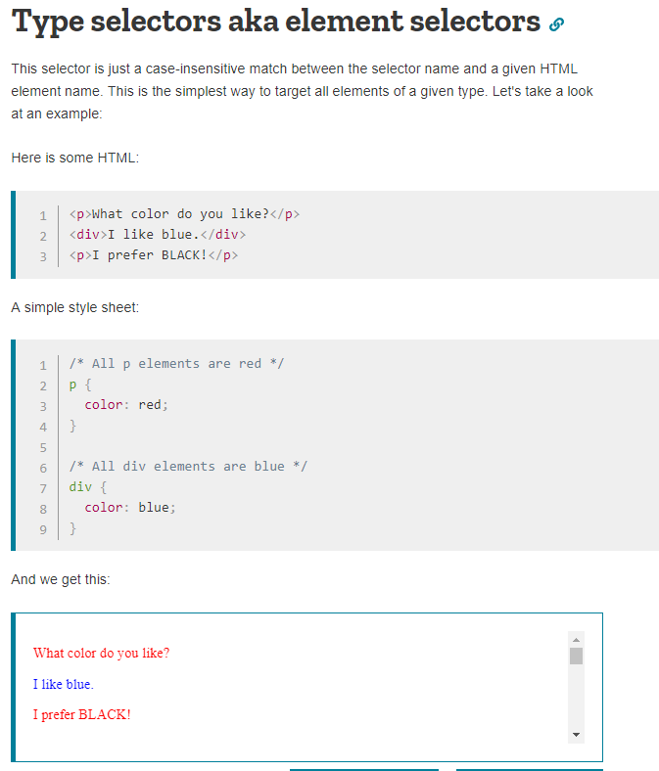
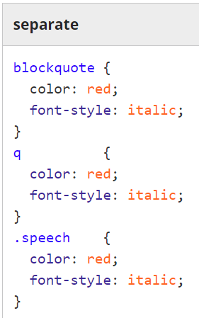
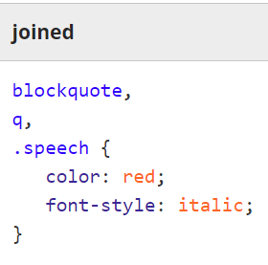
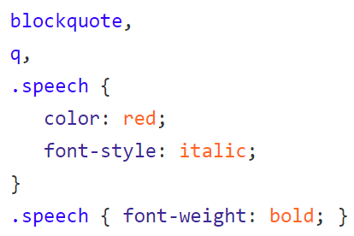
Let's say we want to make all our <blockquote> tags, <q> tags, and anything with "speech" in it's class string, to be red italic text. If the "speech" items need to also be bold, that can simply be added by an additional rule:

Slide 46
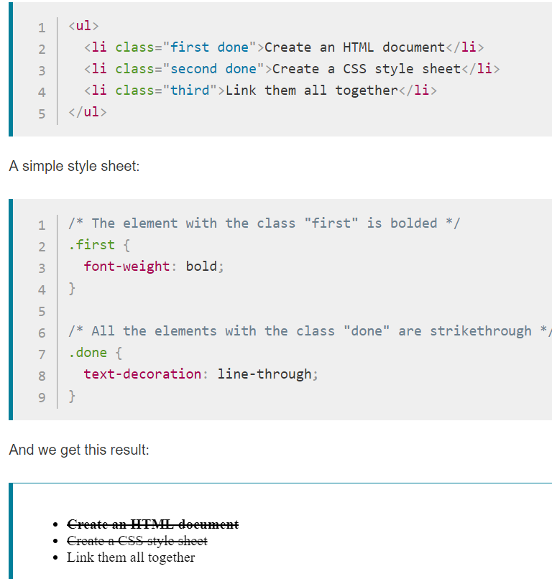
The class selector consists of a dot, '.', followed by a class name

Slide 47
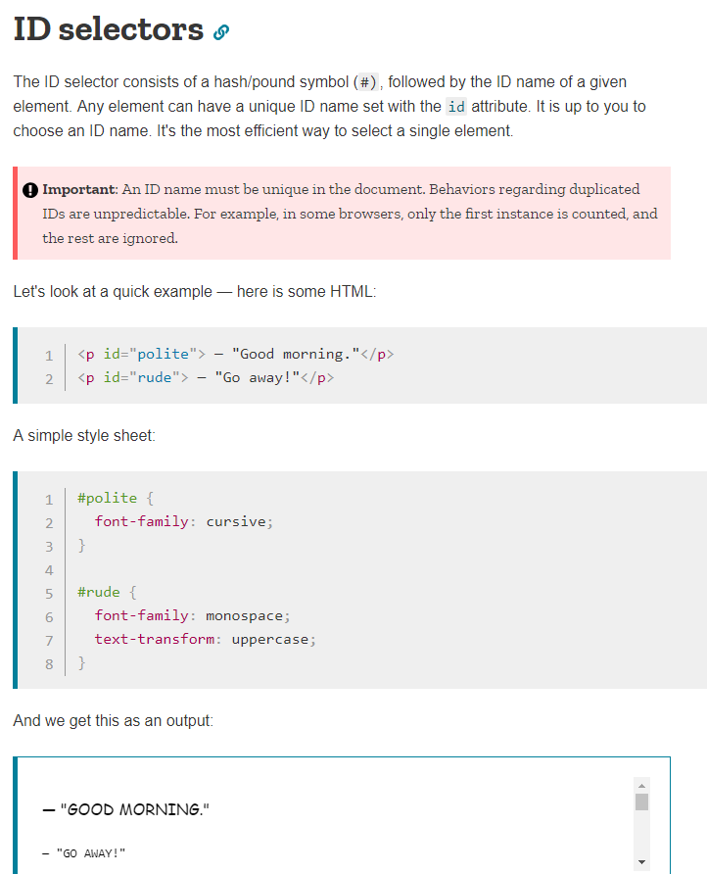

Slide 48
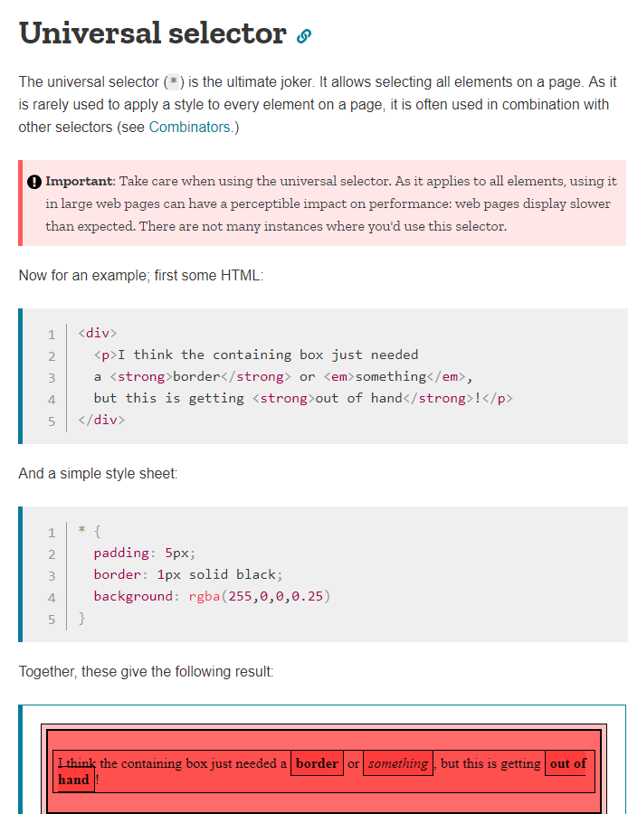

Slide 49
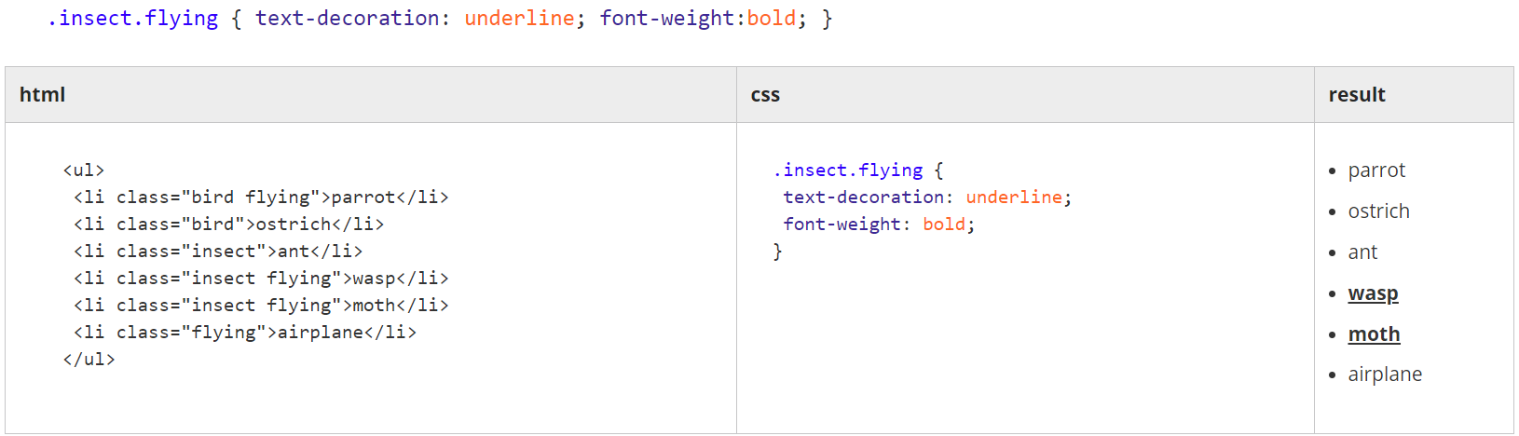
Specialized selectors
If two selectors of different types (like tag and class) appear next to each other with no spacing separating them, then they form a specialized selector. To match, a candidate must match both rules. If a tag selector is used, it must appear first.
In the example above, the blockquote.speech selector is a blockquote tag selector combined with a .speech class selector. So this rule will not necessarily apply to every blockquote, nor every element with the speech class. Instead, it will only apply to those blockquotes that also have the speech class.

Slide 50
Units: px, em, rem, %, vh, vw
font-size, line-height, margins and many other CSS properties expect some sort of dimension value. Dimension values support a wide variety of units.
'px' is short for 'pixel', which is a single dot on the screen. So text with font-size:20px is 20 pixels tall on-screen. In actuality, due to browser zooming, retina displays, or other factors, this may or may not match to 20 physical on-screen pixels.
em
'em' is a typographic term that has come to the Web. On the Web, em units are usually used for vertical dimensions. One 'em' maps to the height of one capital letter in the parent context.
li { font-size: 0.9em; } /* text in a list item is smaller than its parents */
h1 { font-size: 1.2em; } /* but an h1 will be bigger than the parent */
i { font-size: 0.5em; } /* and any italicized text will be half as big. */

Slide 51


Descendant selectors
If you want all the links in the element with id=“intro” to be red, but all the link in the element with id=“guideline” to be green, then
If you want any <a> tags anywhere inside a <blockquote> anywhere inside the tag with id=“intro” to be bold.

Slide 52
Direct descendant selectors ( > )
Sometimes you don't want to apply a style to any _possible_ child, but to only to the direct children. This can be done with the > symbol. Use it between selectors to limit the application to the direct children of the parent.
would cause the links written using <a> inside the tag with id=“intro” only to be larger
Example:
<section id=“intro”>
<a href=“https://www.mammoth.io” target=“_blank”> Mammoth </a>
<p>
<a href=“https://www.mammoth.io/docs “target=“_blank”> Mammoth Documentation</a>
</p>
</section>

Slide 53
Cascading: inheritance and precedence
Most CSS rules once applied to an element are also applied to all the children of that element, and to their children, and theirs ad infinitum. There are exceptions, notably the layout properties (margin, padding, position, width, etc.) and the decorative properties (border, background, etc.) do not cascade. This cascading of a CSS property from parent to child is also called "inheritance".

Slide 54
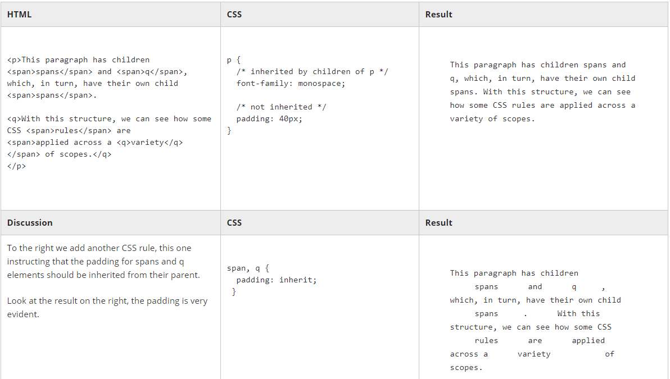

Slide 55
Which rules are inheritable?
There is no reliable rule for which CSS properties are inheritable by default and which are not. However, generally, the properties associated with positioning and layout are not inherited. Likewise, the decorative properties (borders, background images, etc.) do not inherit. Most properties that begin with text- or font- inherit.
A more specific rule takes precedence over a less specific rule.
A rule that more tightly matches a particular element than a general rule will be applied.
span { color: blue; }
ul li span { color: red; }
Rules with an id selector (e.g. #someid ) are considered more specific than rules without
Rules employing a class selector (e.g. .someclass ) are considered more specific than rules without (but not as specific as an #id selector, which trumps everything).
Rules that come later override those that come earlier
This guideline is for two CSS rulesets with the same selector. Where there are conflicts, the rules from the later one apply.
.hortense { color: red; text-decoration: underline; }
.hortense { color: blue; }

Slide 56
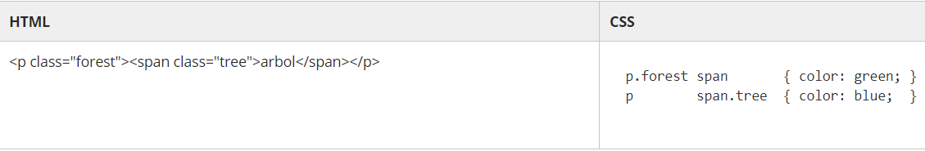
!important
p { color: orange !important; }
Because multiple CSS selectors can resolve to the same element, and because the rules that govern precedence are complex, you may from time to time encounter a situation where you need to apply a particular CSS property and you want it to take precedence over all others, no matter what. !important will do that.
The exclamation point is required, and the whole symbol ( !important ) goes after the value and before the semi-colon ( ; ).

Slide 57
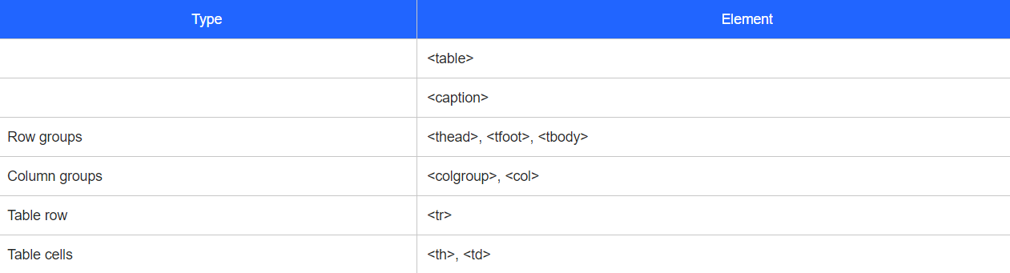
Tables
Tables were not intended as a layout tool, so it is best to stick to them only for tabular data.

Slide 58
The <table> tag
Attribute:
border - has two values, 0 and 1. It is used to specify a border around table cells. 0 - no border, 1 - add border
<caption>
It is used to give a title to the table and should be used as the first child element of <table>
<table border=1>
<caption>
<p>Table 1.0</p>
<p>Student's final exam results 2016</p>
</caption>
</table>

Slide 59
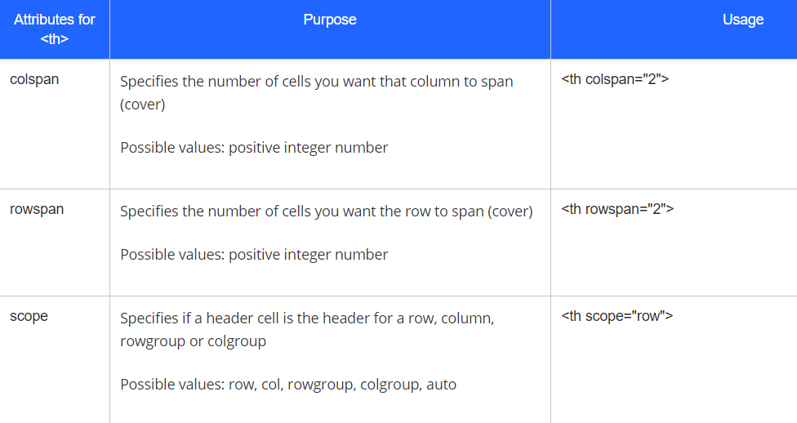
<tr>
Creates a table row.
<th>
Header cell. The content of table header cells is bold and centered by default.

Slide 60
<thead>
Just like how we use <colgroup> to group columns, <thead> is used to group the header content in a HTML table.
As we learned in the previous unit, header cells are specified using <th> as a child of <tr>. Rows specified within <thead> indicate that they are header rows. See the code below:
<thead style="color:white">
<tr>
<th scope="col">Name</th>
<th scope="col">Age</th>
</tr>
</thead>
<tbody>
subsequent rows are considered body rows in a table. Regular cells are specified using <td> as a child of <tr>:

Slide 61
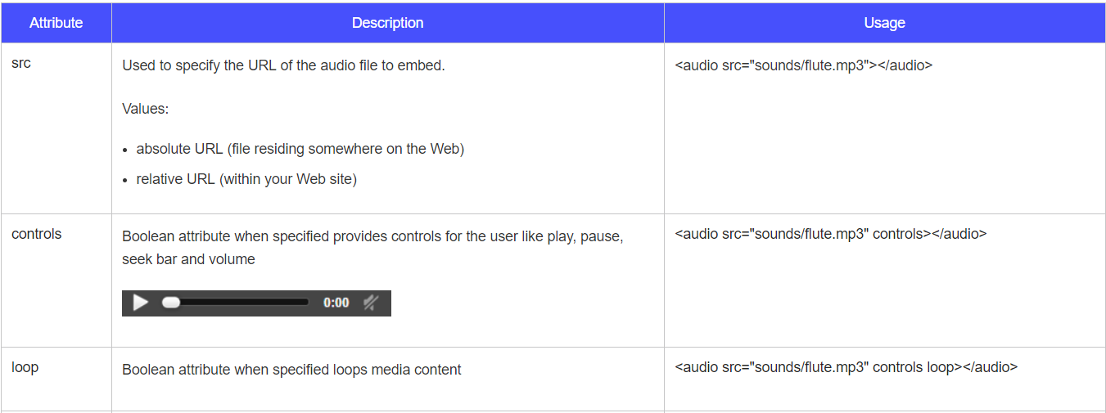
Audio tag

Slide 62
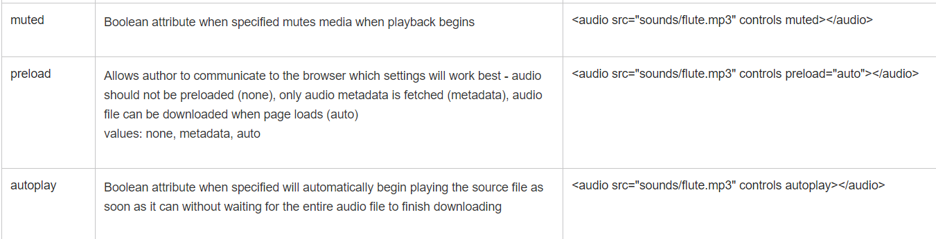

Slide 63
Audio file formats
Just like image file formats, not all audio file formats are supported by all browsers. You will want to use common audio file formats for browser compatibility ensuring the highest probability that your audio file will play.
The most common ones are MP3, WAV and Ogg
There are three major groups of audio file formats - uncompressed (eg: WAV), lossless compressed (eg: MPEG-4, WMA Lossless) and lossy compressed (eg: Opus, MPC, AAC, WMA Lossy).
In uncompressed audio file formats, no compression is applied to the audio file. The memory used for both sound and silence is the same though silence contains less information/data.
In lossless compression, no data is lost but the file is compressed as silence is designed to take up very little space. Compared to uncompressed, lossless compression's compression ratio is approximately 2:1.
Lossy compression provides the greatest compression by simplifying the data and removing some audio information resulting in some loss of quality. It is also the most popular. There are techniques in place to ensure that the parts of sound that is lost has little effect on quality. You can also select a range of compression rates. The larger the rate of compression, the bigger the loss in quality and smaller the file size.
The audio format Ogg Opus has two parts to it. 'Ogg' is a digital container format. It is a specification that describes how different elements of data and metadata work in an audio file. However, it provides no information on how the data is compressed. So a program that opens a container file like 'Ogg' might not know how to decode it. 'Opus', the second part of the audio format, represents the encoding or decoding mechanism for that stream of audio. Opus is a lossy audio coding format.

Slide 64
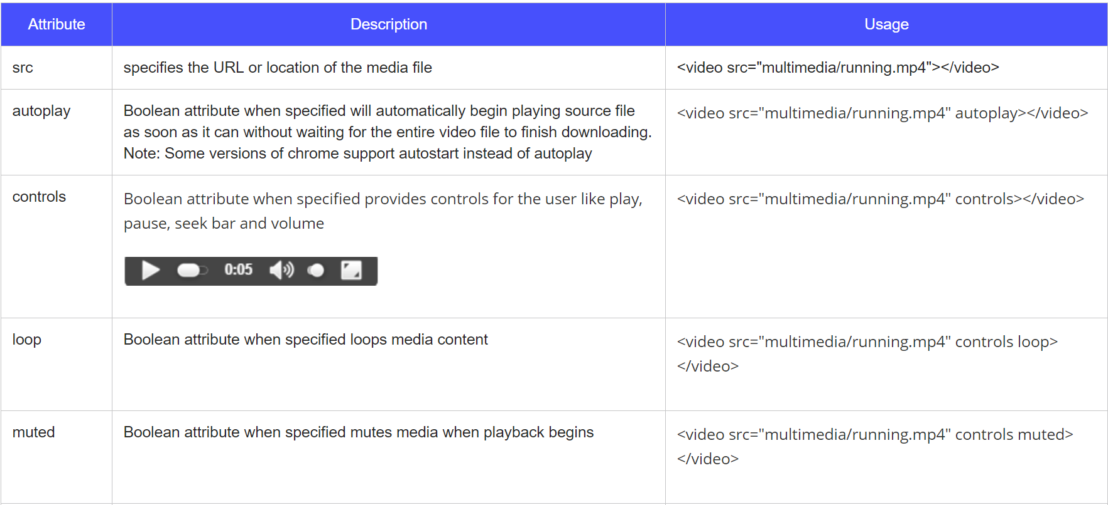
Video element

Slide 65
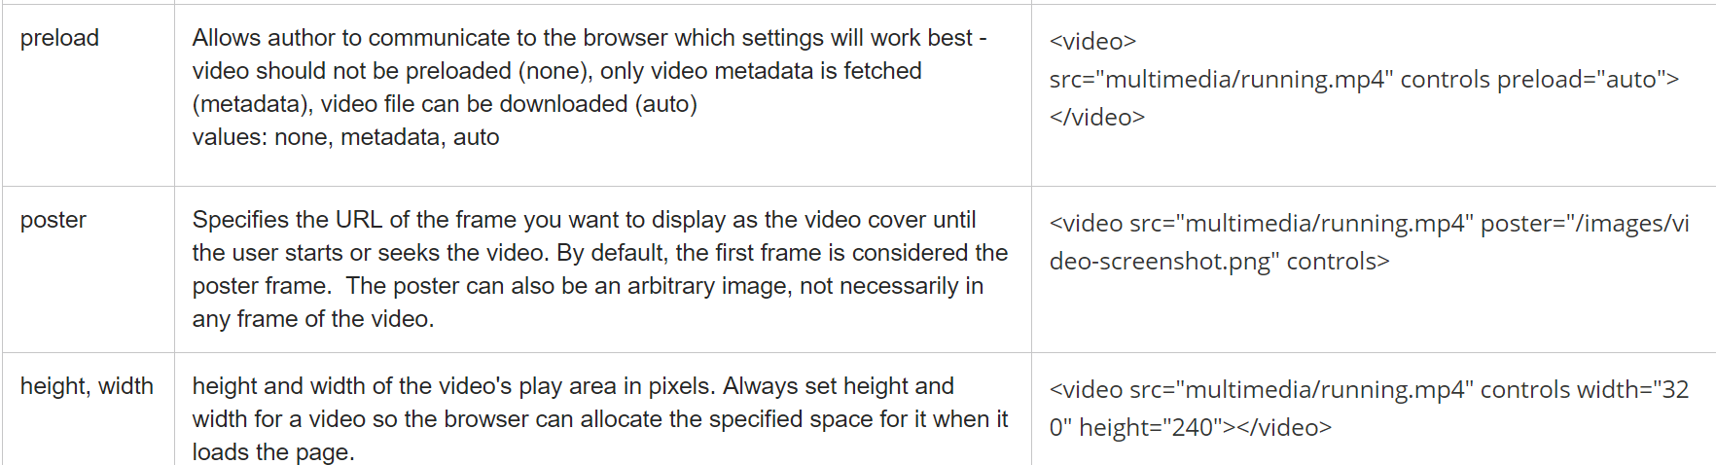

Slide 66
Format to choose apart from video element and browser compatibility:
Most videos go through some form of compression to reduce redundancy in video files and make them smaller, allowing them to download faster. Most also use audio compression techniques to compress sound in video files.
Like audio, there are three major groups of video file formats - uncompressed, lossless compressed (list of lossless video compression formats) and lossy compressed (list of lossy video compression formats).
In uncompressed video file formats, no compression is applied to the video file.
In lossless compression, no data is lost. If you were to uncompress a file compressed using the lossless technique, you will get back the exact same data you started with.
Most videos use lossy compression as it results in significantly smaller video files. Lossy compression provides compression by simplifying the data and removing video information resulting in some loss of quality. There are techniques in place to ensure that the parts of the video that are lost have little effect on quality. You can also select a range of compression rates. The larger the rate of compression, the bigger the loss in quality and smaller the file size. However, if you uncompress a video file that was compressed using the lossy technique, you will not be able to retrieve the same data you put in. With text or spreadsheets, loss of data might be a significant problem. However, with images and video losing a bit of quality is not going to affect the file because you can still make out what the video is about.
The video format 'H.264 and MP3 in MP4' has three parts to it. H.264 is a video compression standard. MP3 is an audio coding format that uses lossy compression for sound in the video. MP4, like Ogg, is a digital container format. It stores audio and video data rather than code the information. A program that opens a container file like MP4 might not know how to decode it. So it requires other standards like H.264 and MP3 to dictate how the video will be coded and possibly compressed.

Slide 67
Track element for captions and subtitles
The <video> element is very similar to the HTML5 <audio> element except for one addition - the <track> element. The <track> element is used to add timed text like subtitles, captions or any text you would like to display to the user when the video is playing.
Web Video Text Tracks (WebVTT) files are the standard to include subtitles or captions.
Captions and subtitles are not the same. Subtitles are meant to translate the language (for those who do not understand the language being spoken in the video). Captions are meant for the deaf or people who have difficulty hearing. It includes sound effects and other significant audio like music and lyrics and is usually in the same language as the audio
Like the <source> tag, you can add multiple <track> tags in your video element to add multiple subtitle/caption tracks. This is commonly done when providing them in different languages

Slide 68
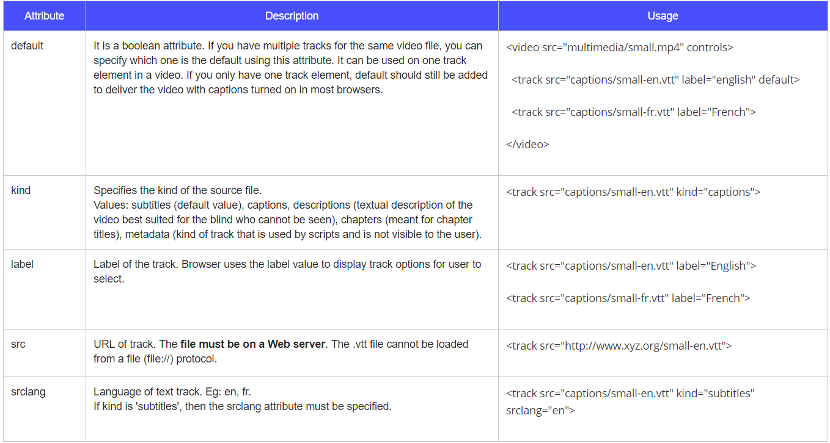

Slide 69
The iframes tag
There are tags for all kinds of content in your Web page, text, images, videos, animations. There's even a tag that allows you to put another Web page in your Web page - the <iframe> tag (HTML Inline Frame Element)
Certain Web sites like Google and Yahoo disallow embedding their Web pages in iframes. So you will not be able to use these pages in an iframe.
Not all attributes are supported in all browsers. You are encouraged to explore their browser support before adding to your HTML.

Slide 70
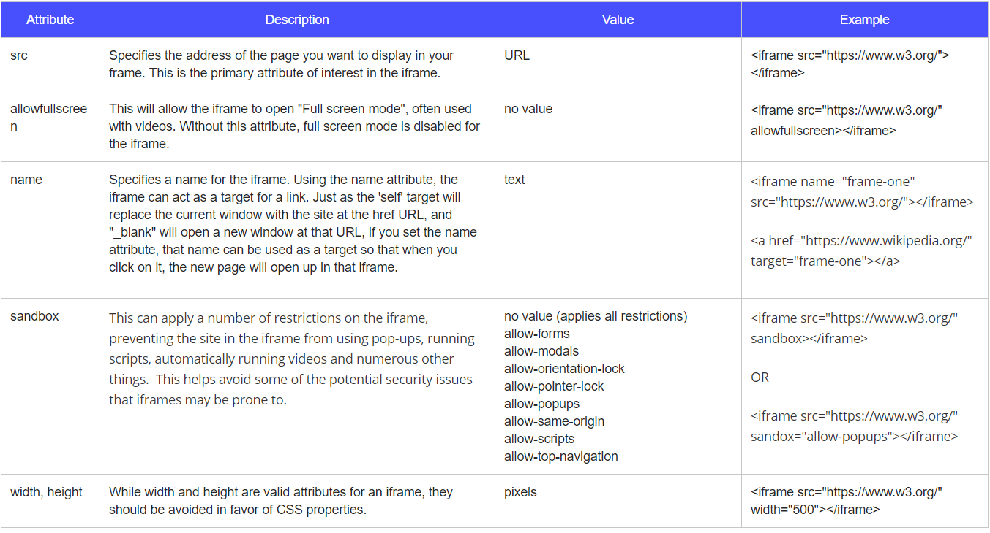

Slide 71
Iframes can be very useful:
Iframes load separately from the main page. However, they do block the main page's load command until its content finishes loading. You can avoid this by applying some Javascript. This allows them to load independently. Then, if the embedded page you are displaying loads slower, you can use your parent page to keep the reader occupied.
Sandboxing provides security.
Great for third party content like ads.
It is convenient to use if you need to have one part of your page static while the other is changed - i.e. navigation menus. Helps reduce bandwidth and server load because we can avoid loading the same content every time a new page is visited in your webpage.
However, there can be some disadvantages:
It is easy to misuse them. It should be considered a piece of content in the webpage and not as an integral part of it.
Accessibility of iframes is poor. Screenreaders do not process them well but you can proceed to use iframes with a notice for the reader.
You have no control over the content in an iframe if you display external content. That content can change anytime or can upload malicious content without your permission.
Search engines have trouble accessing and in turn indexing the content in your iframes. This doesn't help your search ranking.

Slide 72
CSS best practices
Executive summary
Logical source order:
The order of the HTML content should make sense even without the CSS: for accessibility, mobile optimization, device adaptability, and long-term maintainability.
Liquid layouts and relativity:
Use smart relative sizing: to optimize layouts while minimizing media query code forks.
Media queries:
Adapt to screen size changes; get font size adaptation free by using ems.
Prevent zombie code:
Dead code may come alive as CSS changes. Delete it before it does, and ruins your layout.
Test in multiple browsers: Your favorite browser is not always right.
Don't use proprietary features! Keep the Web open to everyone! Don't rely on the latest -WebKit- invention.
Turn off CSS: A well-coded page will be understandable without it.

Slide 73
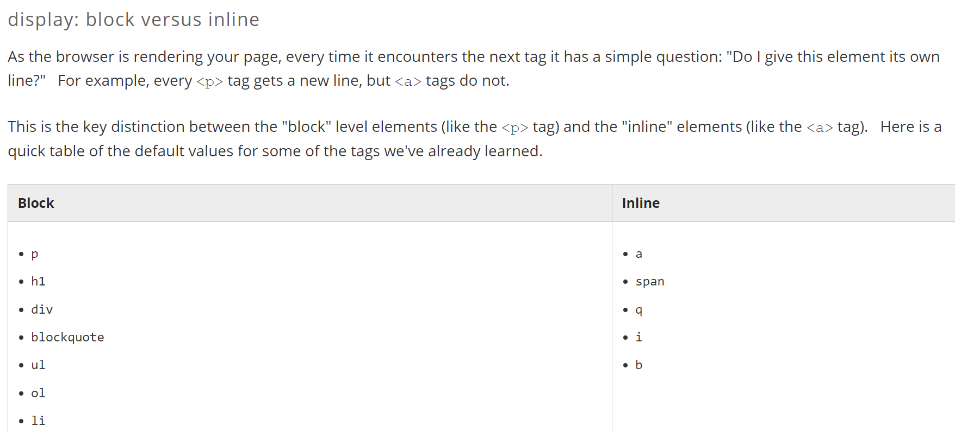

Slide 74
Block Level
The block level:
appears below and to the left of their block level neighbors (like a carriage return on a typewriter going to the next new line)
will expand to fill the width of the parent container by default
respects all margin properties
can have its width property set, which will make it narrower and cause its children to wrap, but not crop. (We'll cover this later)
takes on the height of all its children (pending certain exceptions) as long as its own height is unset. (We will cover setting the height later)
ignores the vertical-align property

Slide 75
Inline elements:
simply appear to the right of their preceding inline neighbor. They do not drop to the next line unless they must "wrap".
by default, the width is simply the width of the content of the element, plus any padding
ignore top and bottom margin settings
ignore width and height properties
are subject to vertical-align property as well as CSS white-space settings
support padding, but any padding-top or padding-bottom does not contribute to the calculation of the height of the text line it sits upon
cleave to the baseline where they are being placed

Slide 76
inline-block
inline-block elements respect margin-top and margin-bottom
the vertical padding for inline-block elements contributes to the calculation of the height of the line it falls on
inline-block elements respect width and height properties

